Slide 1
If housing inventory is so tight, why are so many homes vacant?
A PowerPoint Summary of http://lenkiefer.com/2017/09/17/housing-vacancy-trends/

Slide 2
Summary
Earlier this year we talked about how limited housing supply was helping to drive accelerating house prices across the country. In such an environment you would expect to see housing vacancies decline. Indeed, if you look at the rate of rental or homeowner vacancies you see a substantial reduction. But if we look a little closer at the housing inventory data something curious emerges.

Slide 3
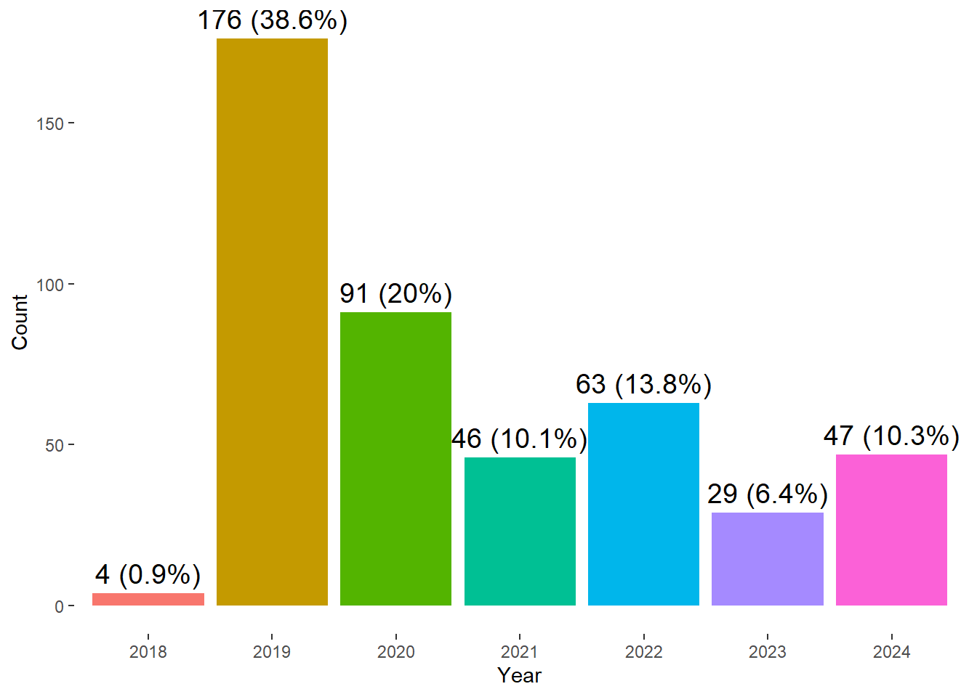
Homeowner and rental vacancy rates have declined
During the Great Recession homeowner vacancy rates spiked, and gradually came back down. Rental vacancy rates did not spike nearly as much, but also came down in recent years as housing markets have gotten pretty tight.

